Slide 1
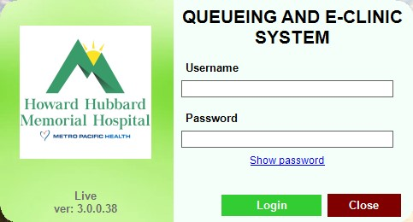
QUEUING MANAGEMENT SYSTEM

Slide 2
SELF QUEUING KIOSK
(PRIVATE PATIENT)

Slide 3
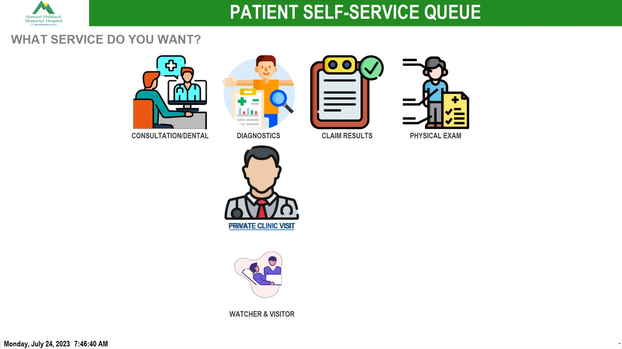
PATIENT WILL CHOOSE TRANSACTION

Slide 4
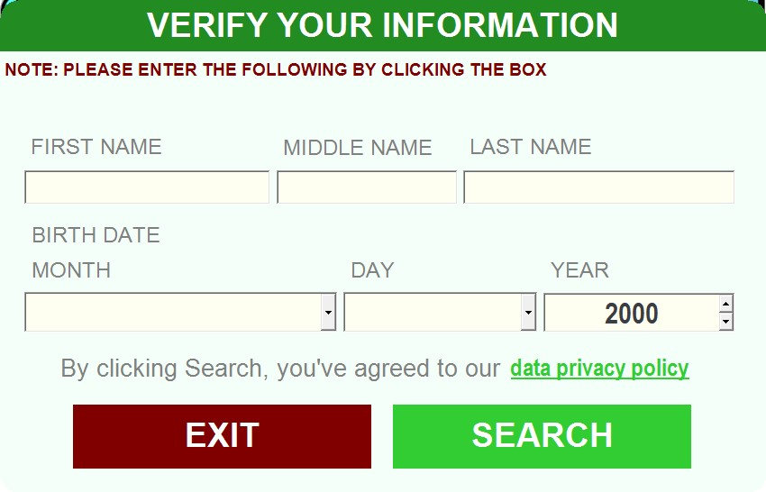
PATIENT WILL ENCODE DETAILS
THE CLICK SEARCH

Slide 5
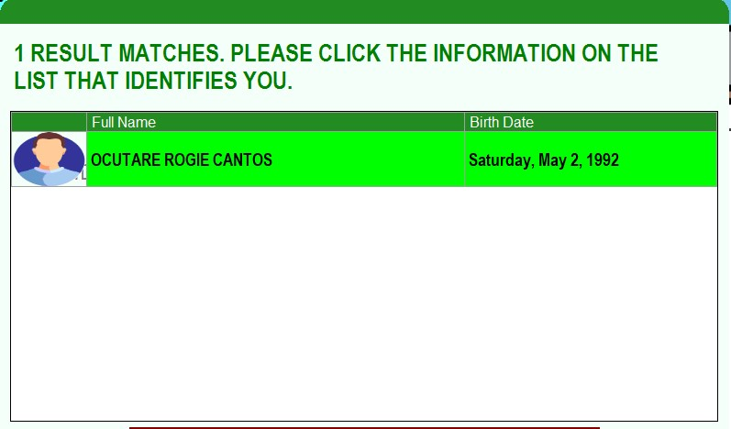
DOUBLE CLICK THE NAME

Slide 6
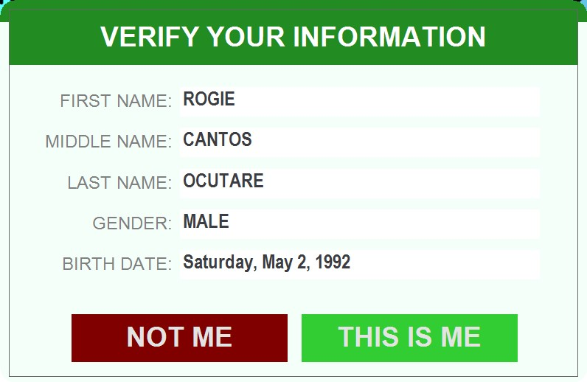
CONFIRMING IF THE DATA IS CORRECT

Slide 7
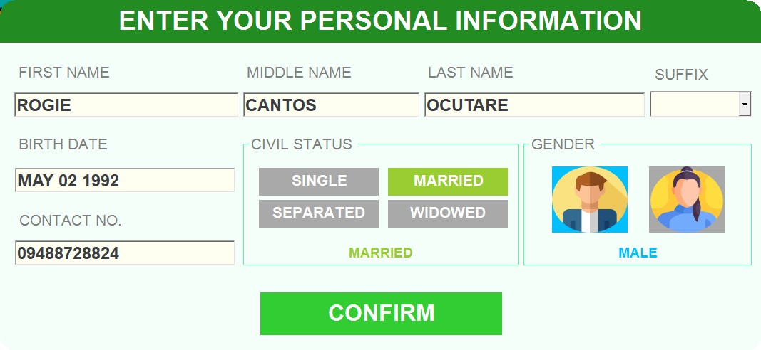
IF PATIENTS DATA HAS CORRECTION THEY CAN EDIT IT THEN CLICK CONFIRM

Slide 8
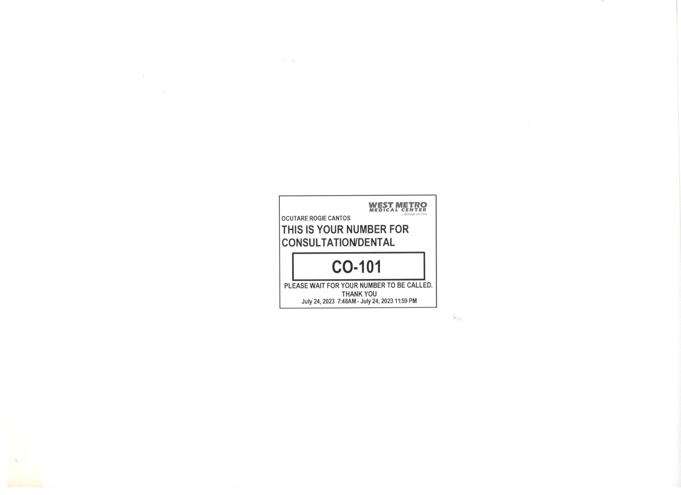
A PRINTED NUMBER WILL BE GENERATED

Slide 9
THE OPD STAFF WILL PROVIDE RE-VALIDIATION OF TICKET AND TAKING UP VITAL SIGNS

Slide 10
REGISTRATION AREA

Slide 11
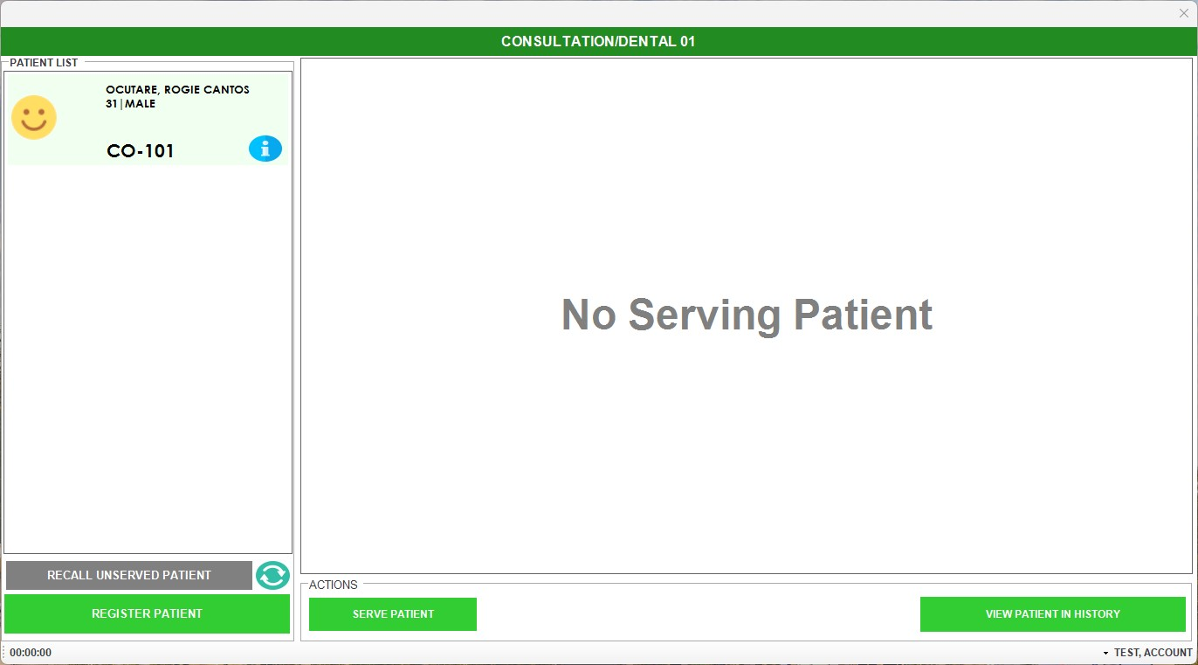
ENCODER WILL SERVE THE PATIENT

Slide 12
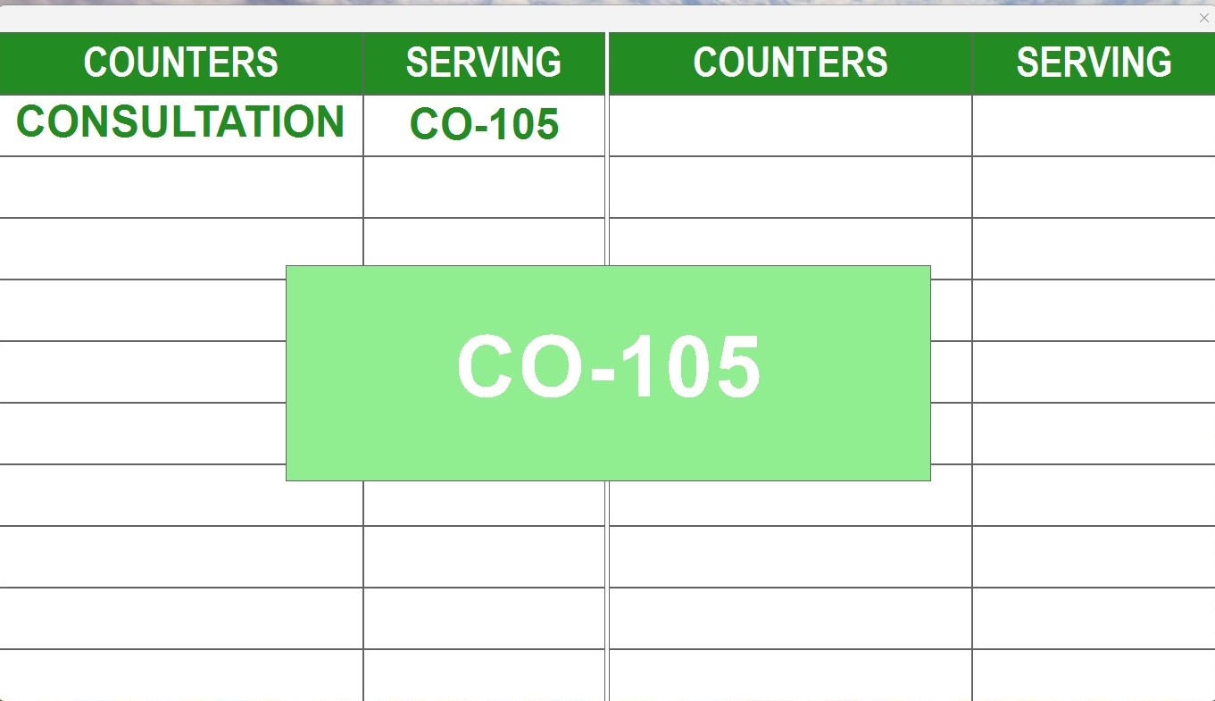
Note: There will be a tune to hear and Queue number will appear on the TV

Slide 13
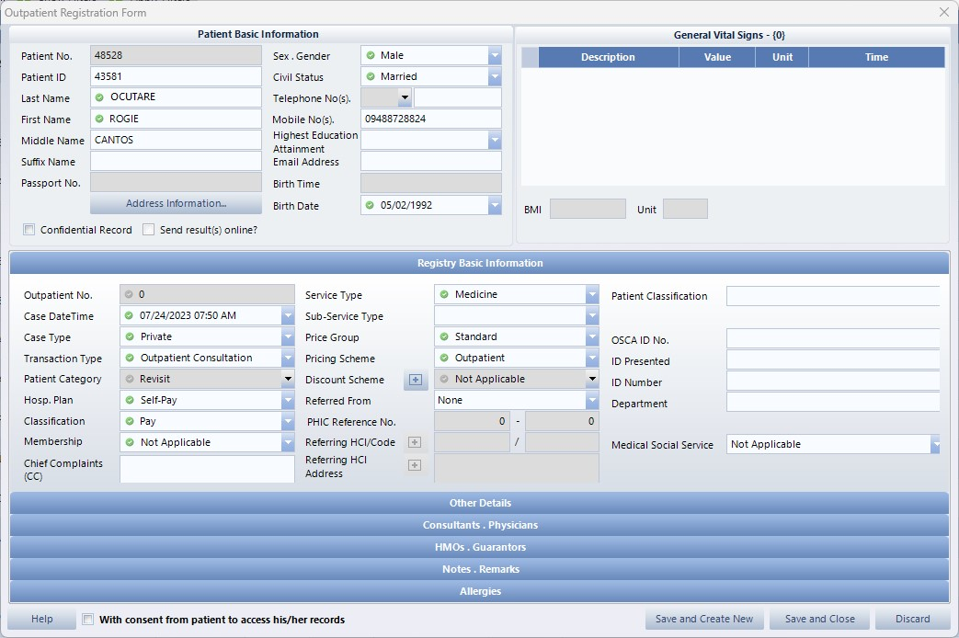
ENCODER WILL REGISTER PATIENT TO HIS

Slide 14
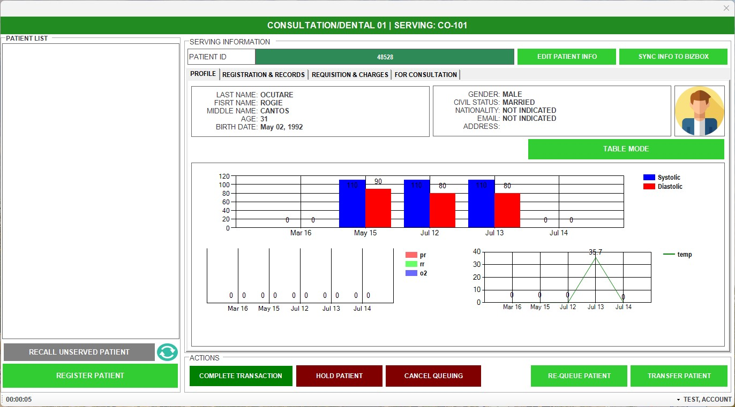
ENCODER WILL CLICK REGISTRATION & RECORDS

Slide 15
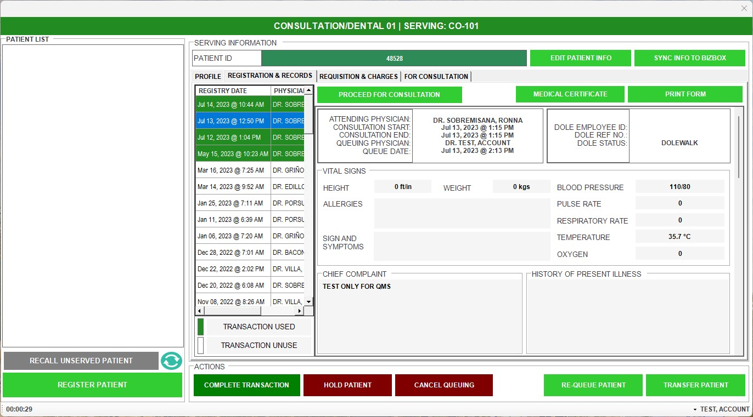
ENCODER WILL CLICK PROCEED FOR CONSULTATION

Slide 16
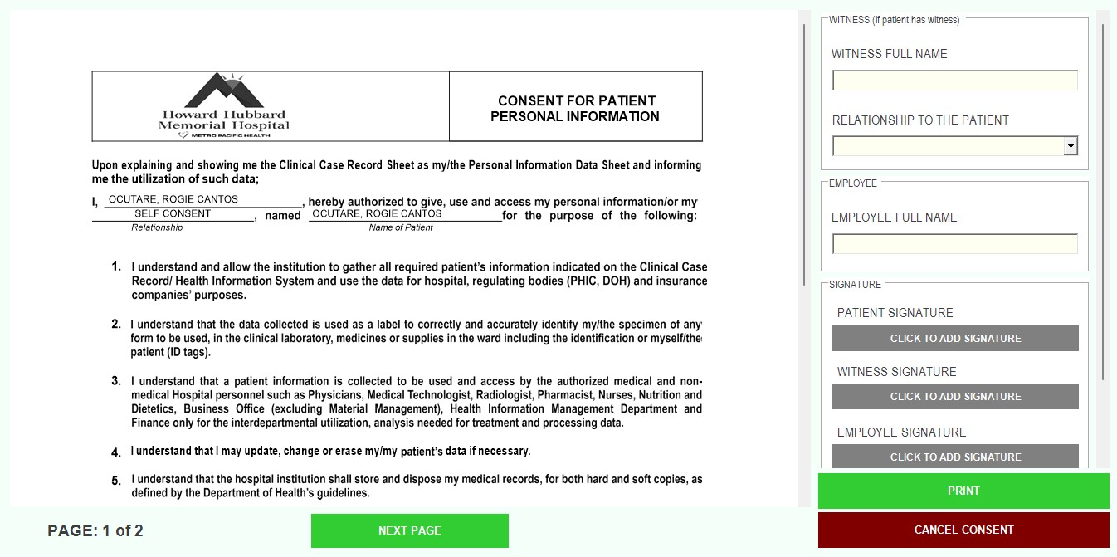
ENCODER WILL ASK THE PATIENT FOR CONSENT SIGNATURE AND CLICK ADD SIGNATURE

Slide 17
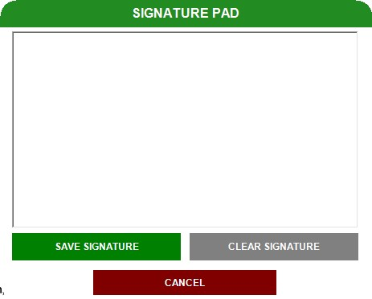
THE PATIENT WILL SIGN ON THE SIGNATURE PAD

Slide 18
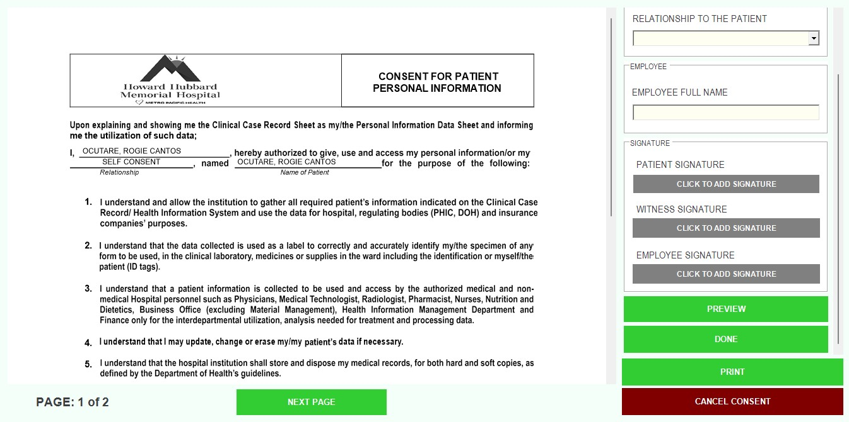
AFTER THE SIGNATURE IS ATTACHED ENCODER WILL CLICK DONE

Slide 19
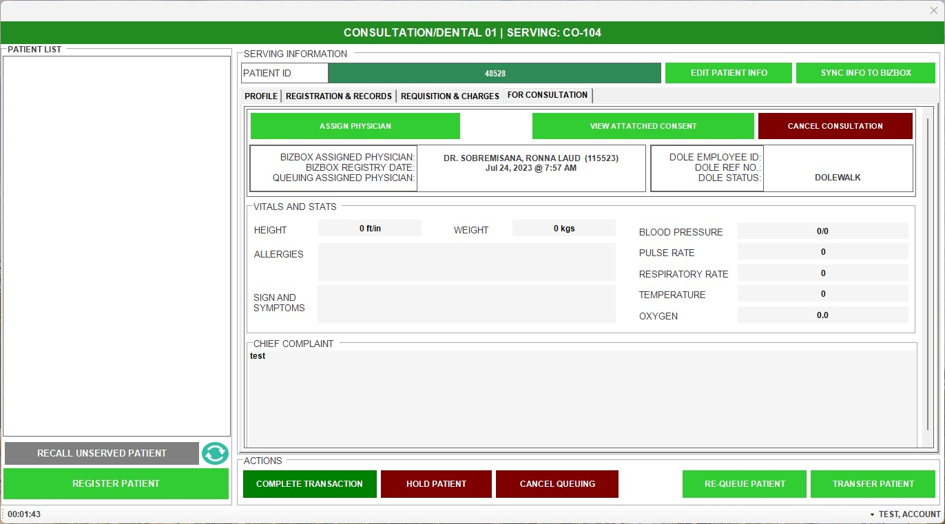
ENCODER THEN WILL ASSIGN QUEUING ASSIGNED PHYSICIAN

Slide 20
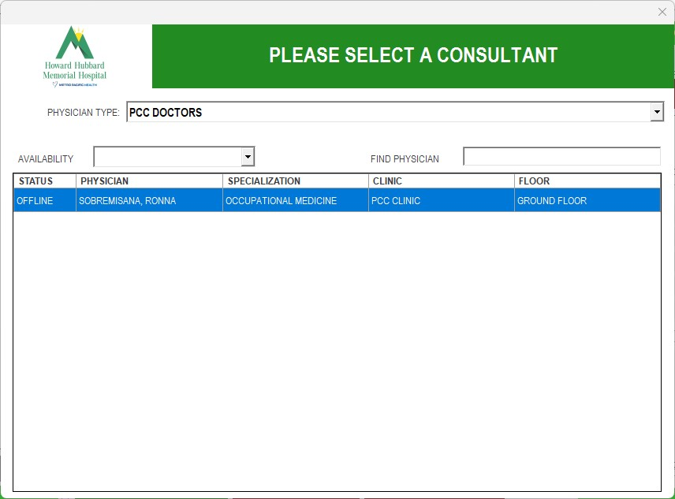
ENCODER THEN WILL SELECT THE PHYSICIAN

Slide 21
ENCODER THEN WILL TRANSFER PATIENT TO THE OPD CASHIER

Slide 22
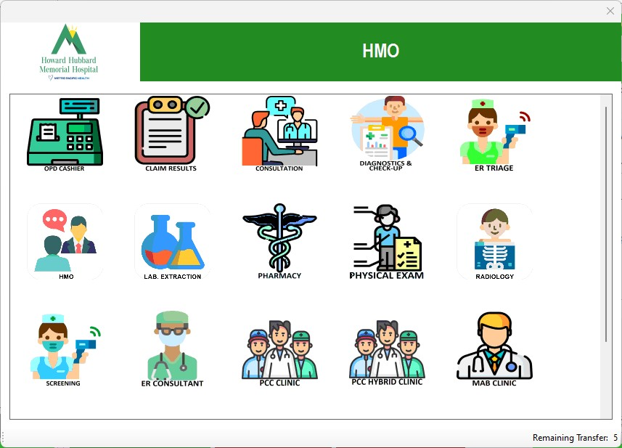

Slide 23
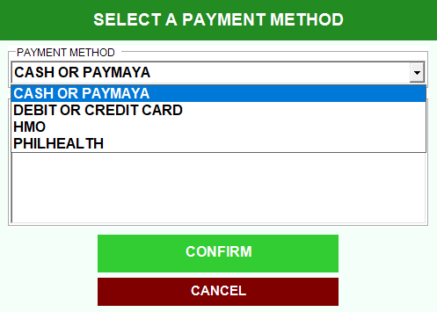
ENCODER THEN WILL NOW SELECT THE MODE OF PAYMENT

Slide 24
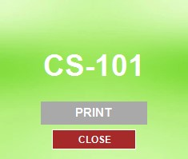
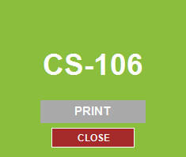
QMS THEN WILL GENERATE PRINTED TICKET

Slide 25
CASHIER AREA

Slide 26
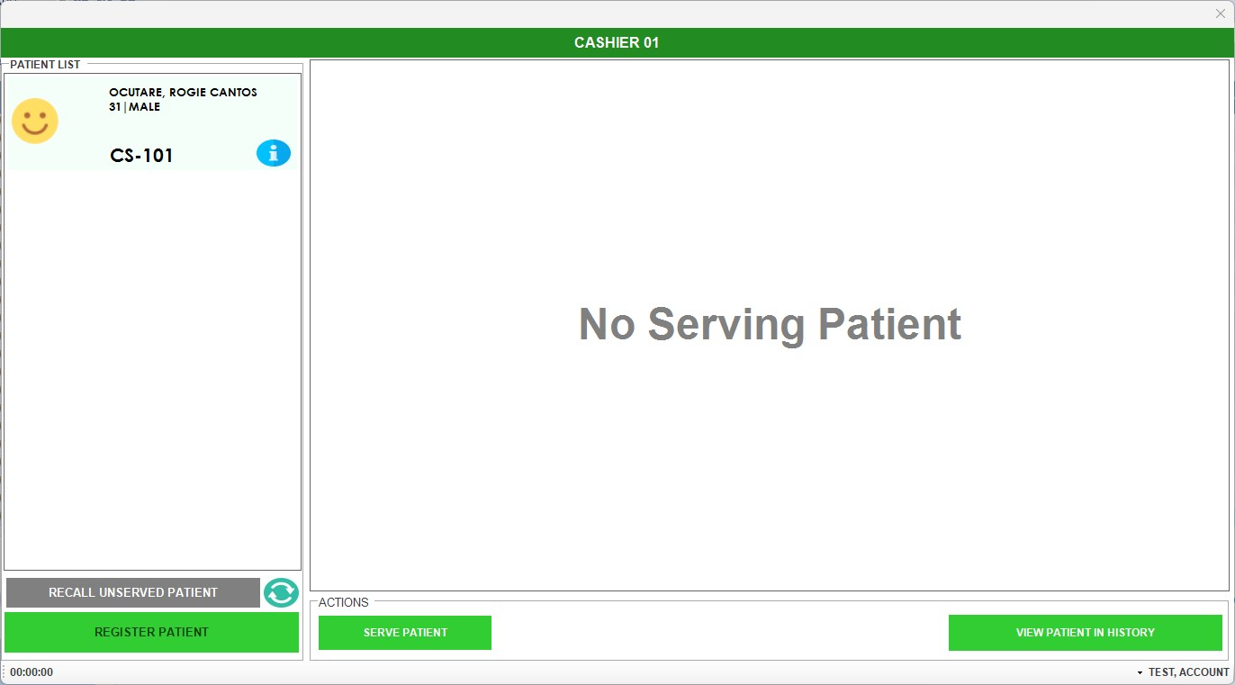
CASHIER WILL CLICK SERVE PATIENT

Slide 27
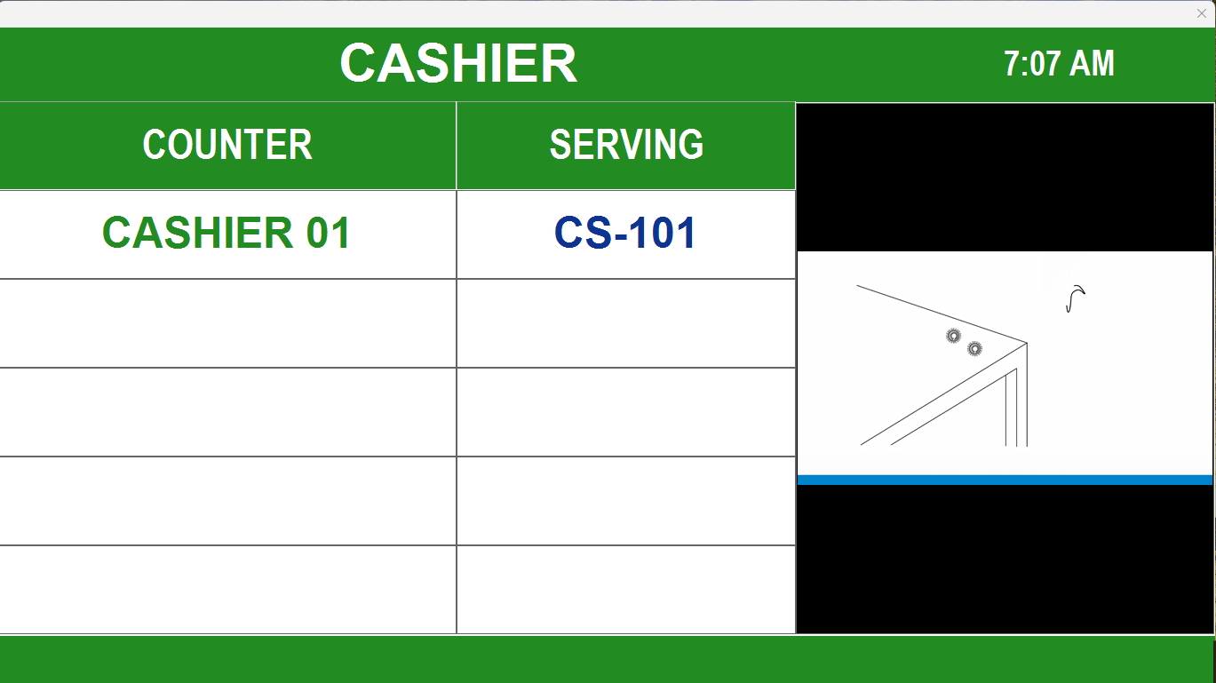
There will be a tune to hear and Queue number will appear on the Queueing board TV

Slide 28
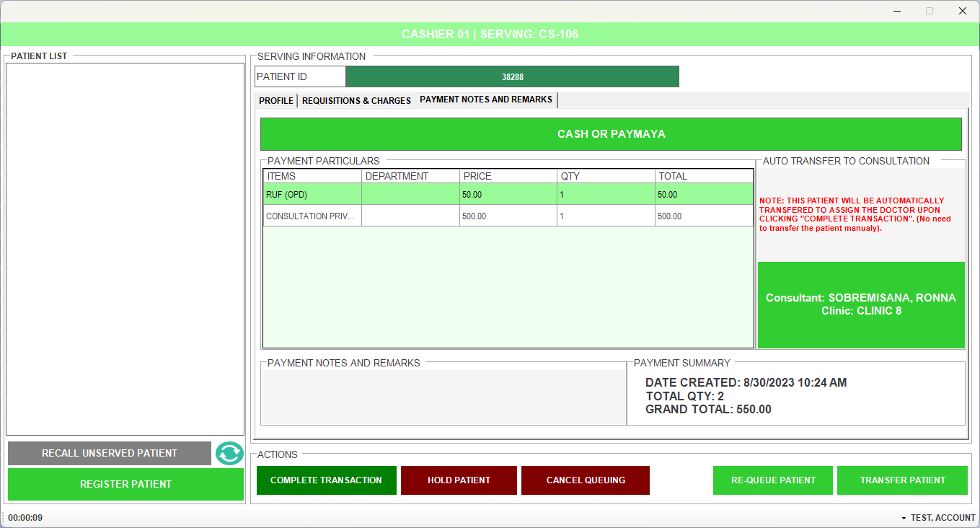
CASHIER THEN WILL COLLECT THE PAYMENT FOR CONSULTATION, THEN TRANSFER PATIENT TO THE DOCTOR

Slide 29
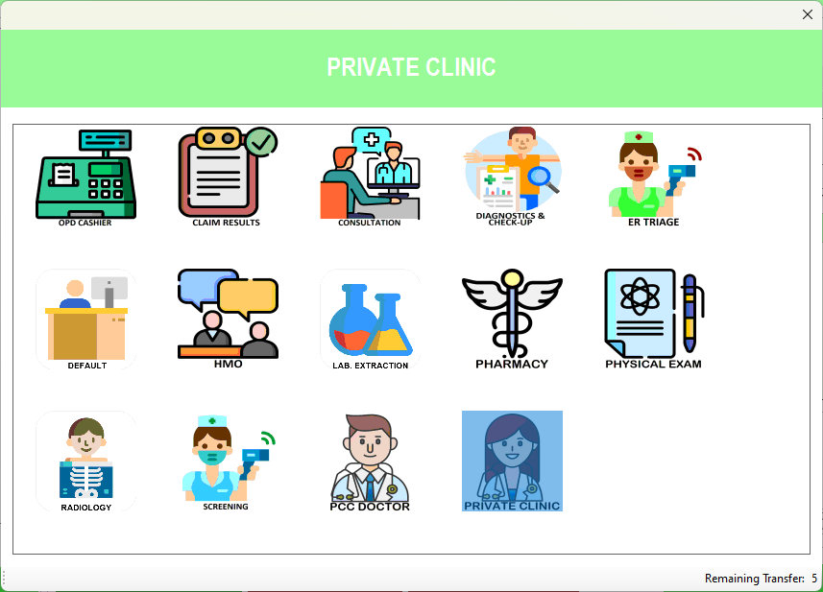
TRANSFER PATIENT TO:

Slide 30
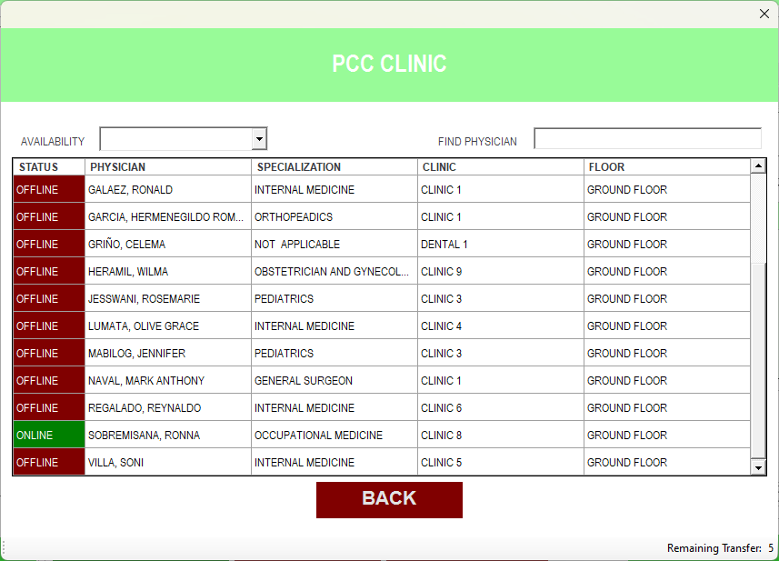
SELECT THE PATIENT’S DOCTOR

Slide 31
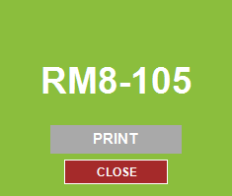
QMS THEN WILL GENERATE PRINTED TICKET GOING TO THE ASSIGNED PHYSICIAN

Slide 32
DOCTOR’S MODULE

Slide 33
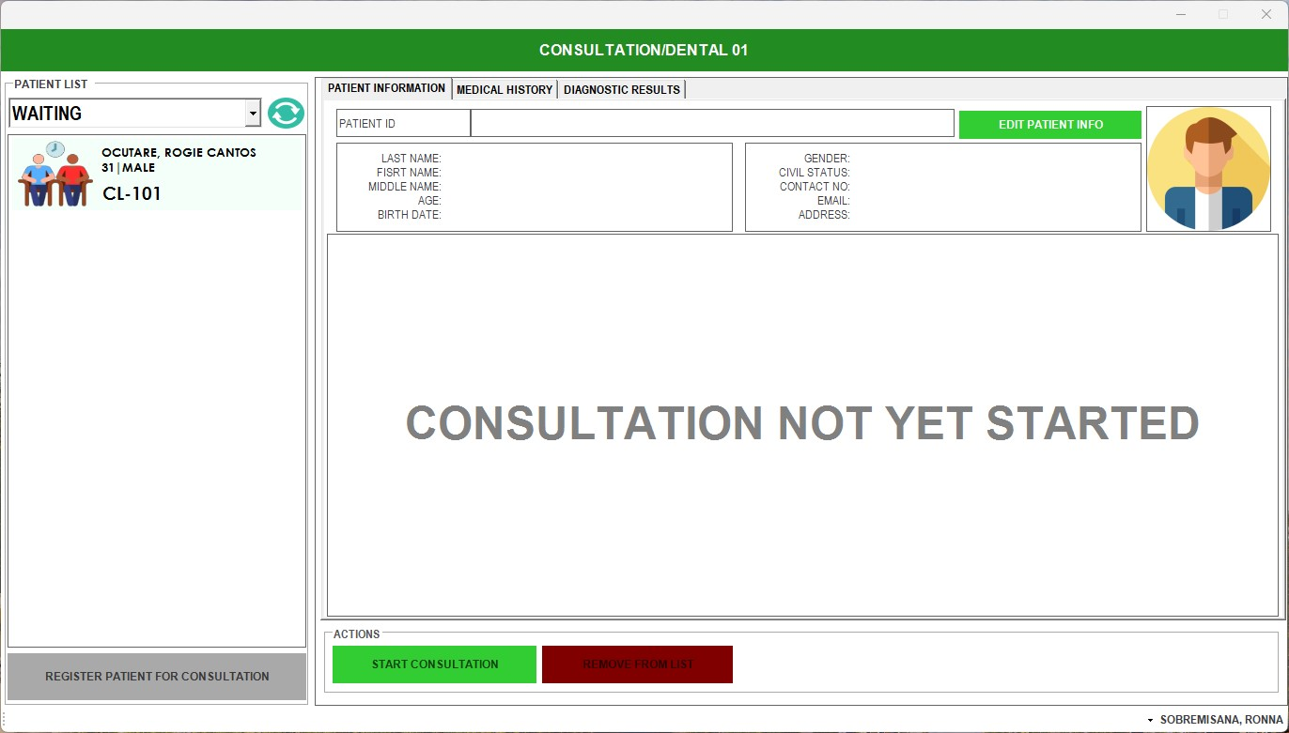
DOCTOR WILL SEE IF THERE ARE PATIENTS WAITING, THEN SERVE IF READY. THEY WILL CLICK THE NAME WITH THE LATEST NUMBER THEN CLICK START CONSULTATION

Slide 34
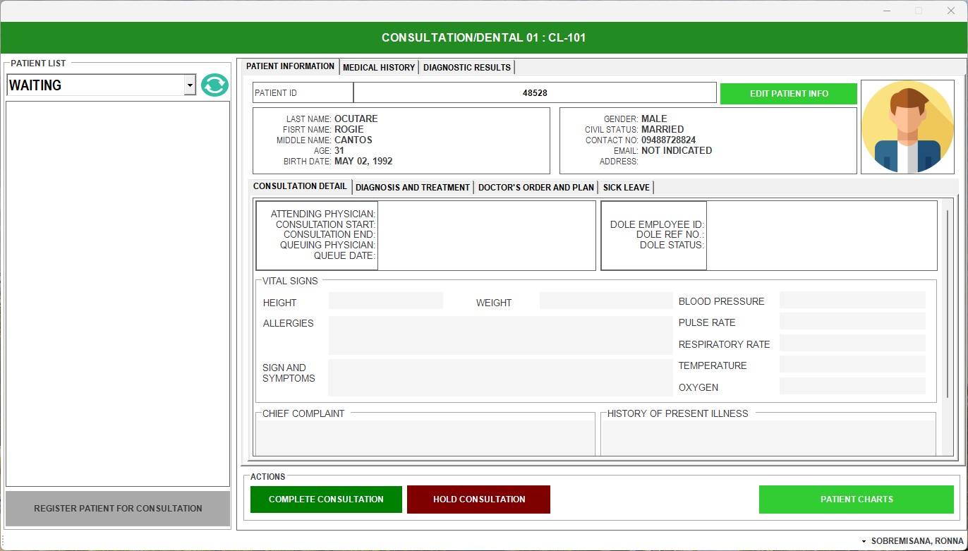
AFTER SERVING THIS WOULD BE THE APPEARANCE, THEN THE PATIENT WILL GIVE THE PRINTED NUMBER TO THE DOCTOR

Slide 35
THE DOCTOR WILL OPEN ELECTRONIC MEDICAL RECORDS (EMR)

Slide 36
THEN THE DOCTOR WILL INPUT ALL THE SOAP & SICKLEAVE TO EMR.

Slide 37
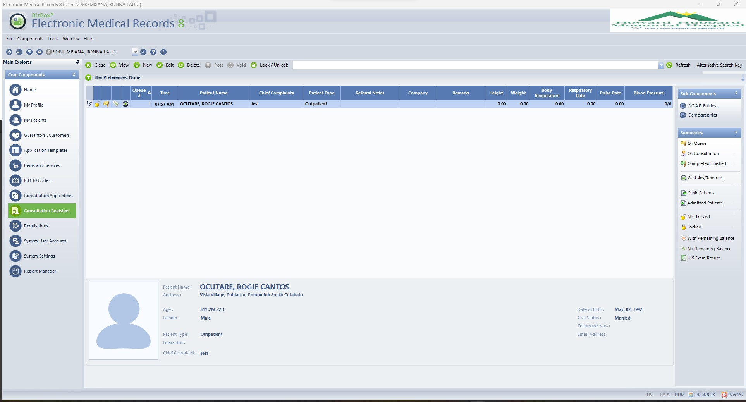
CLICK PATIENT’S NAME THE CLICK S.O.A.P. ENTRIES

Slide 38
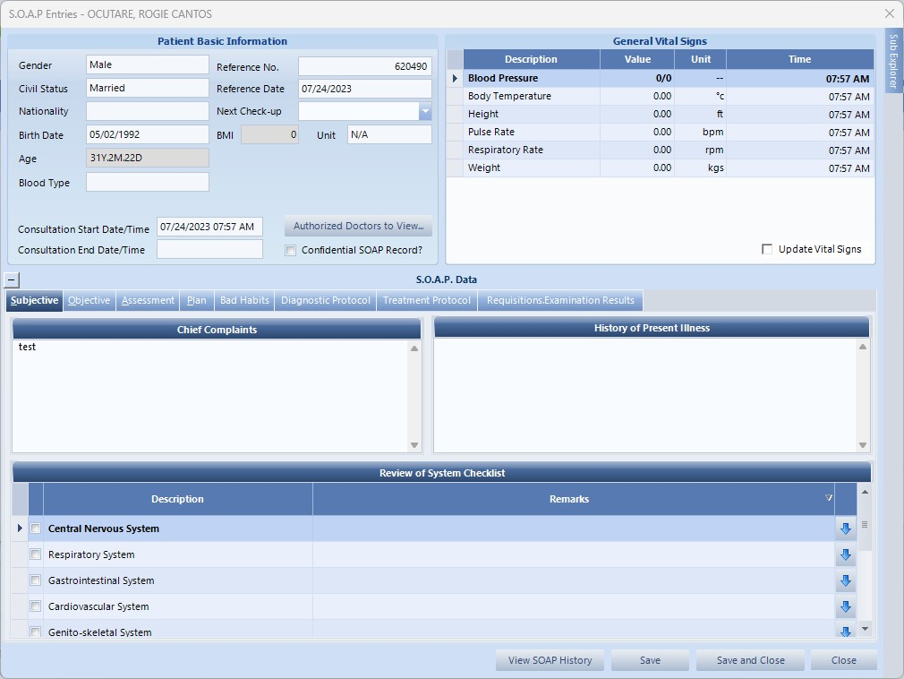
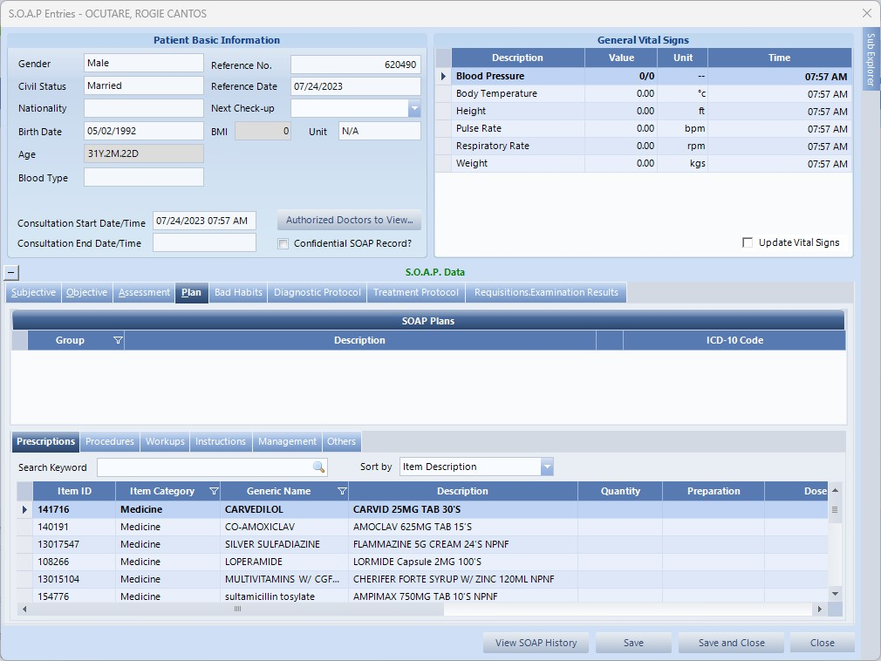
THEN THE DOCTOR WILL INPUT THE S.O.A.P. ENTRIES

Slide 39
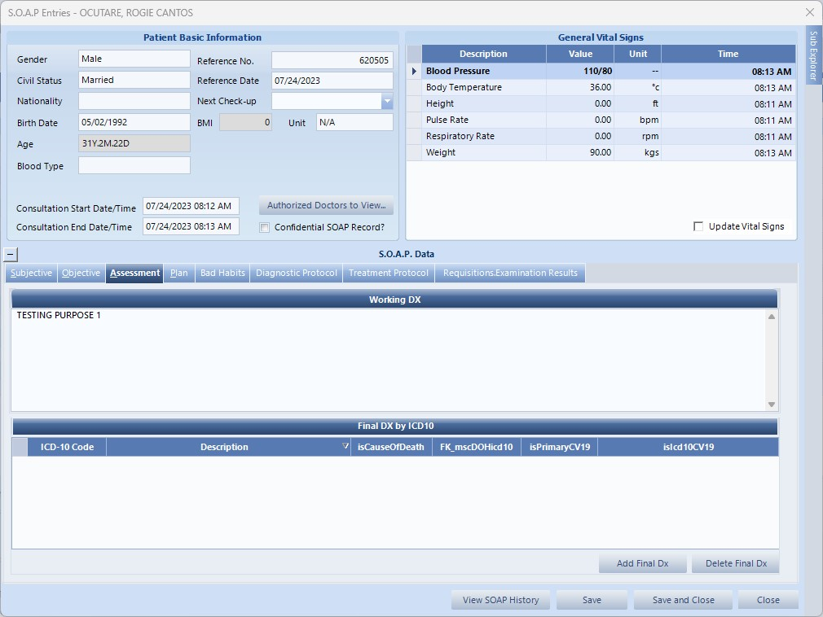
AFTER PUTTING ASSESSMENT, PLEASE ADD FINAL DIAGNOSIS

Slide 40
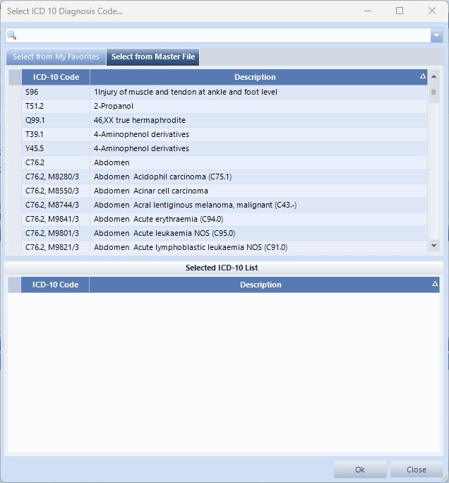
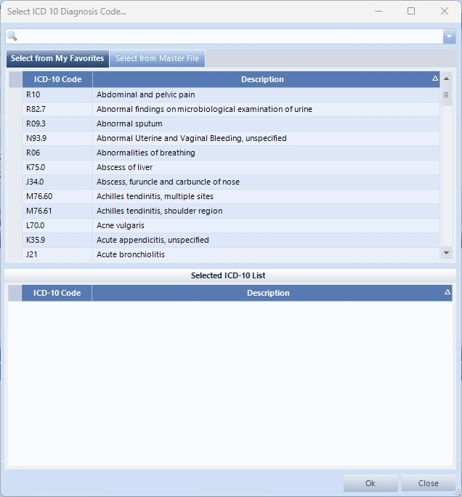
SEARCH THE FINAL DIAGNOSIS VIA ICD-10 CODE OR DESCRIPTION

Slide 41
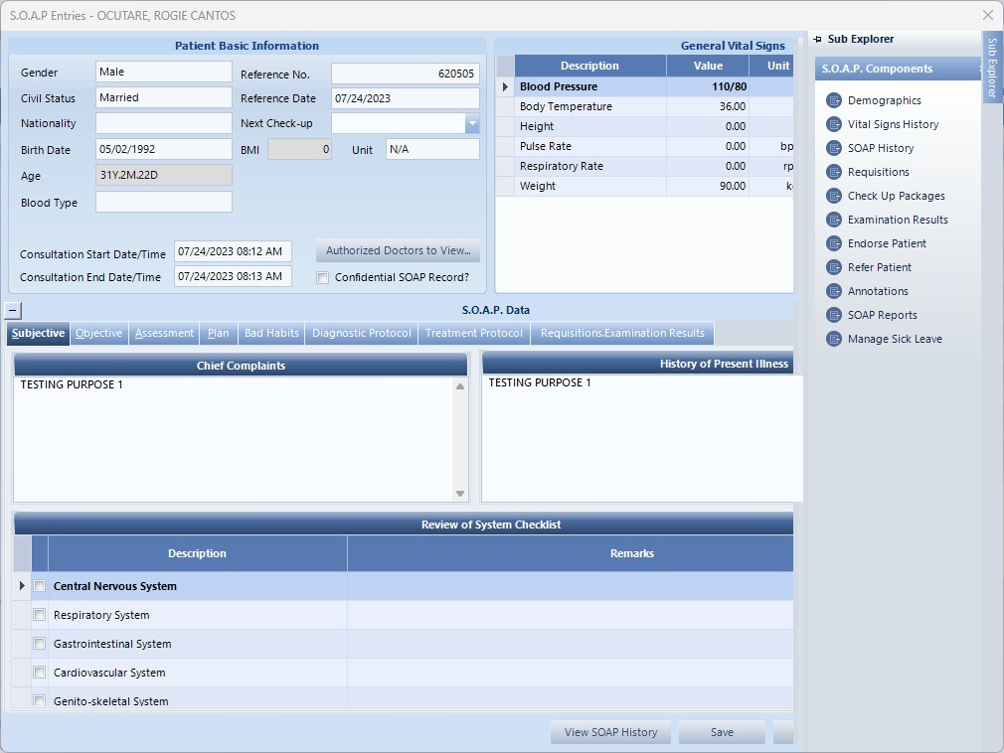
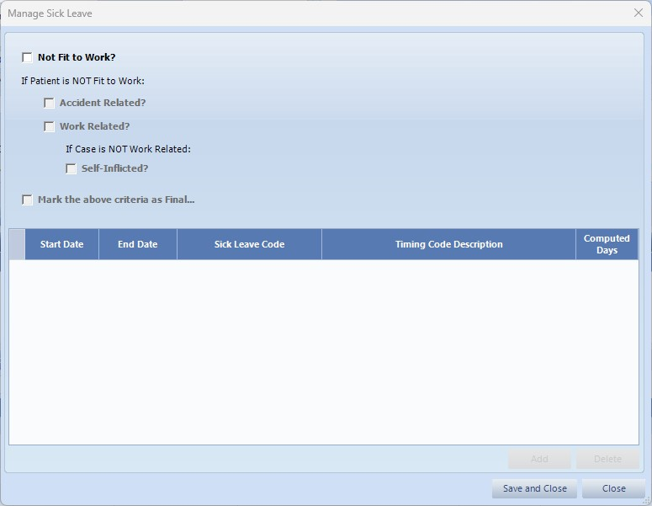
AND IF DOLE EMPLOYEE, PLEASE DON’T FORGET TO PUT THE SICKLEAVE OF THE PATIENT
THEN CLICK SAVE AND CLOSE

Slide 42
THEN IF THE DOCTOR ORDERS DIAGNOSTICS & MEDICINES, OPEN HIS FOR REQUISITIONS.

Slide 43
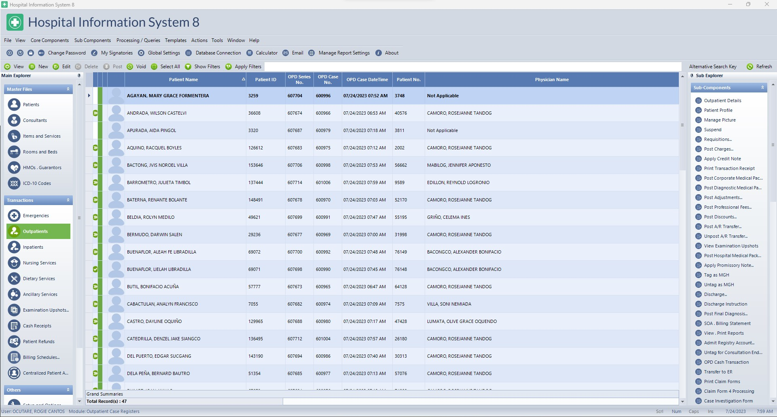
OPEN OUTPATIENT MODULE, FIND THE PATIENT THEN CLICK REQUISITIONS

Slide 44
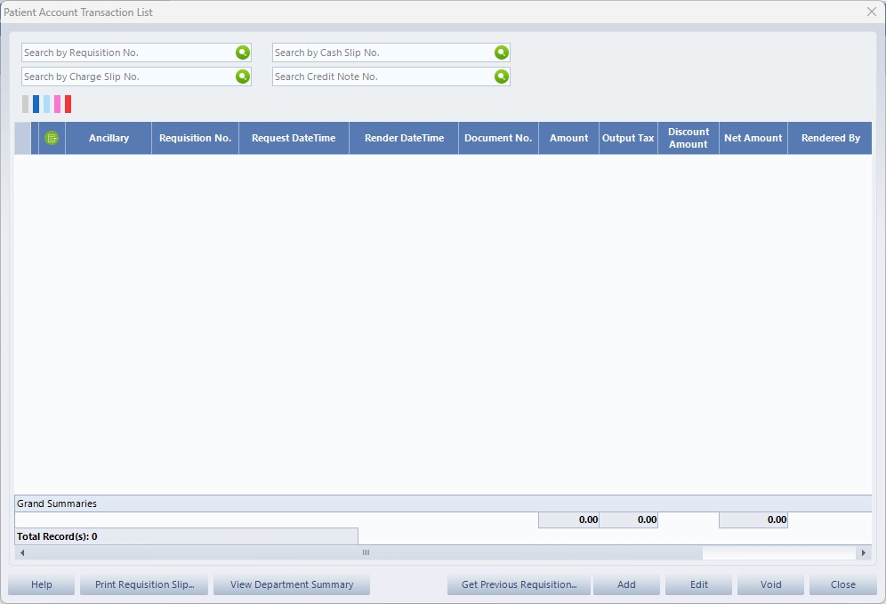
OPEN OUTPATIENT MODULE, FIND THE PATIENT, CLICK REQUISITIONS THEN CLICK ADD

Slide 45
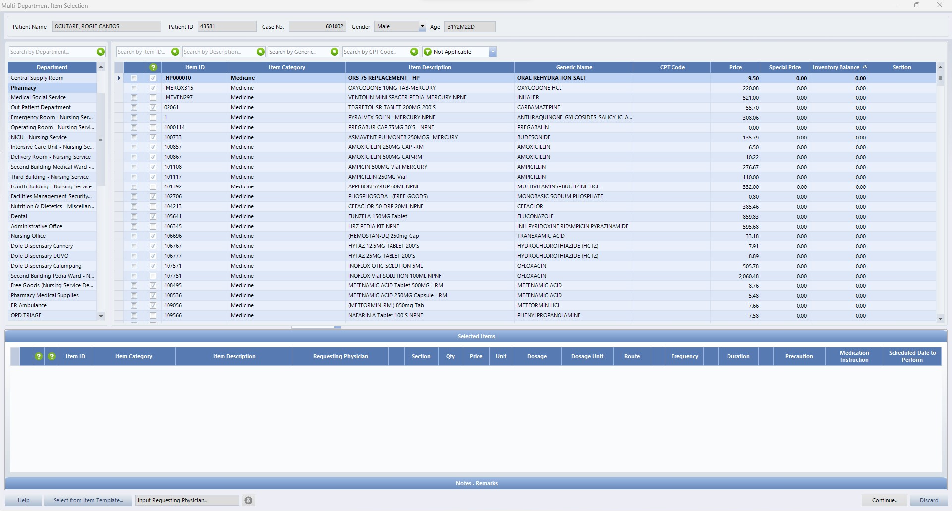
IF MEDS CLICK PHARMACY, IF DIAGNOSTICS CLICK LABORATORY & RADIOLOGY. CLICK SEARCH BY DESCRIPTION THEN SEARCH THE DESIRED ITEM.

Slide 46
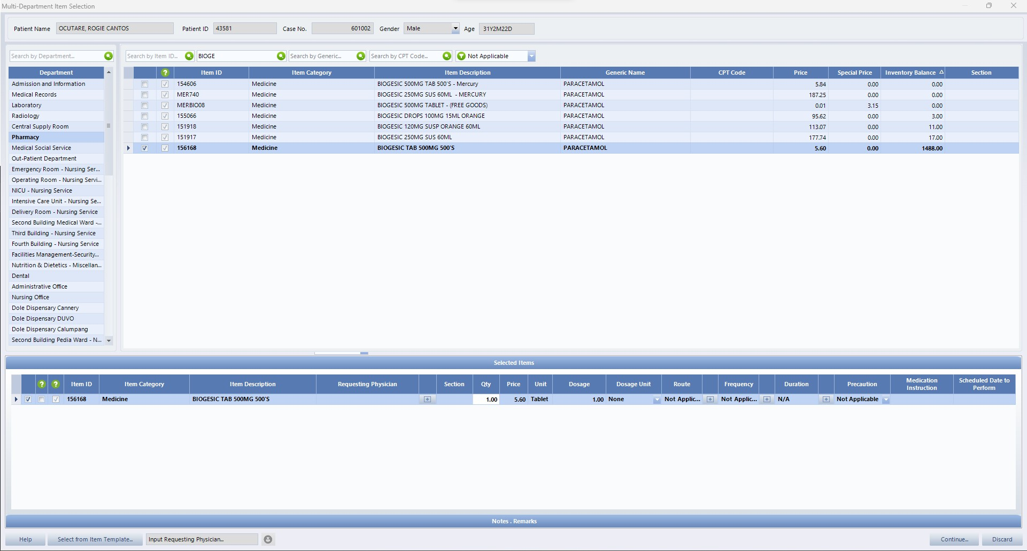
SAMPLE 1. THE ORDER IS BIOGESIC, SEARCH BIOGESIC. THEN ADD THE QUANTITY AND CLICK CONTINUE

Slide 47
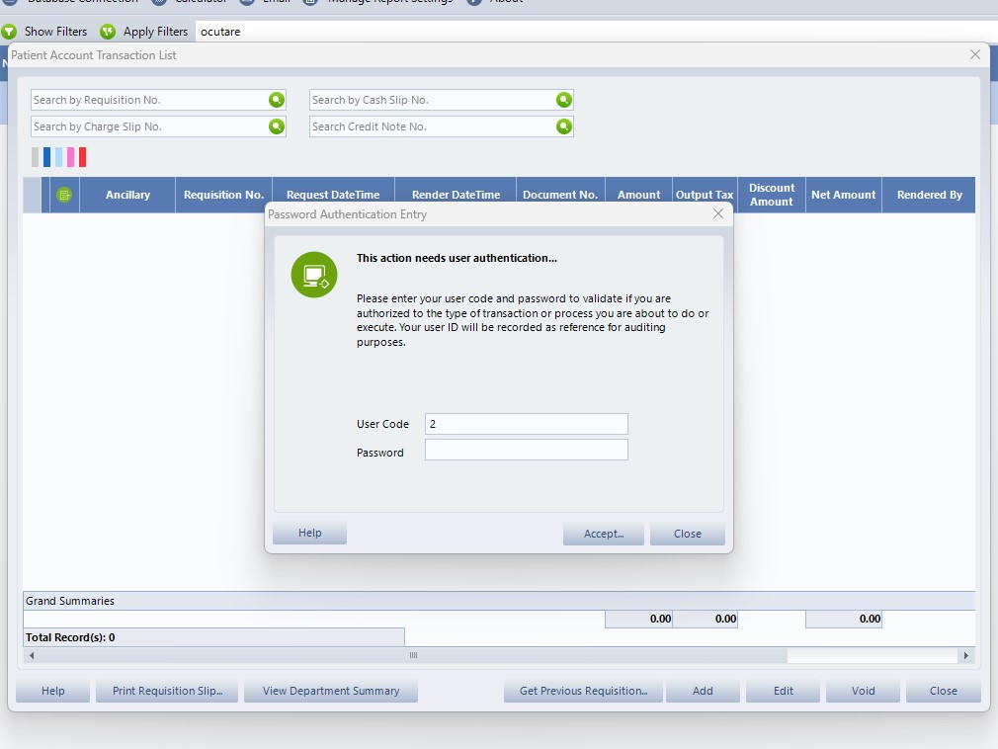
THEN INPUT PASSWORD TO CONFIRM TRANSACTION

Slide 48
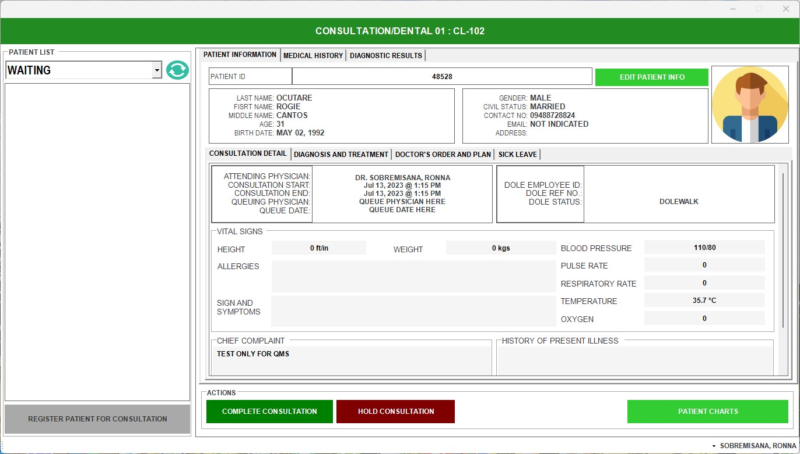
THE DOCTOR WILL GO BACK TO QMS THEN CLICK REFRESH TO SEE THE DATA ENCODED AT EMR

Slide 49
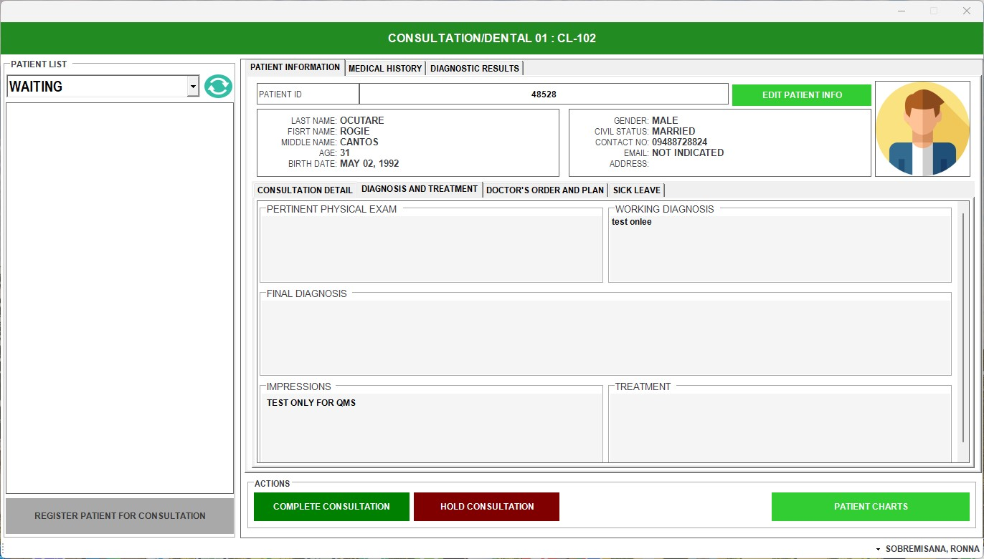

Slide 50
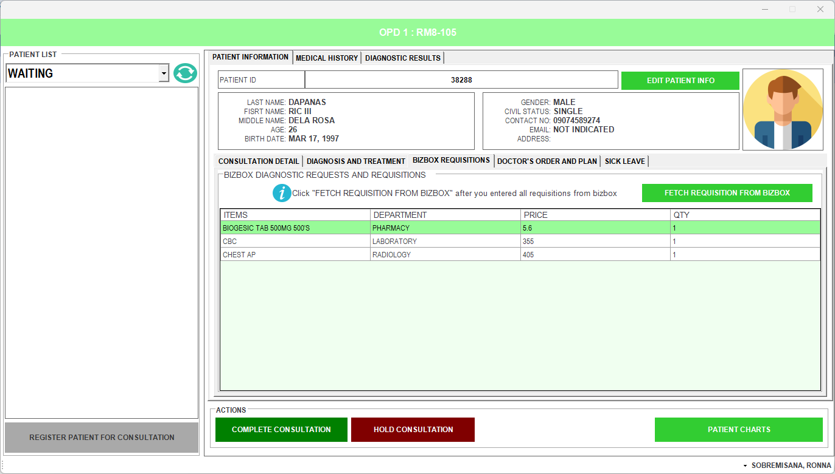

Slide 51
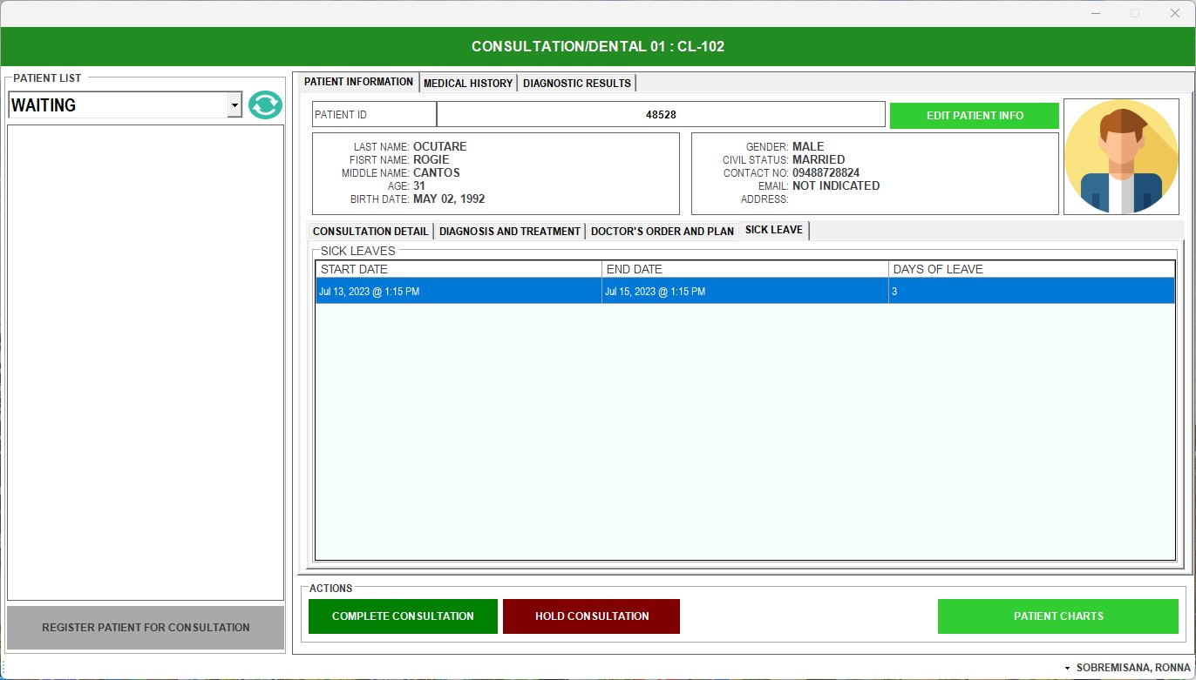

Slide 52
THEN INPUT PASSWORD TO CONFIRM TRANSACTION

Slide 53
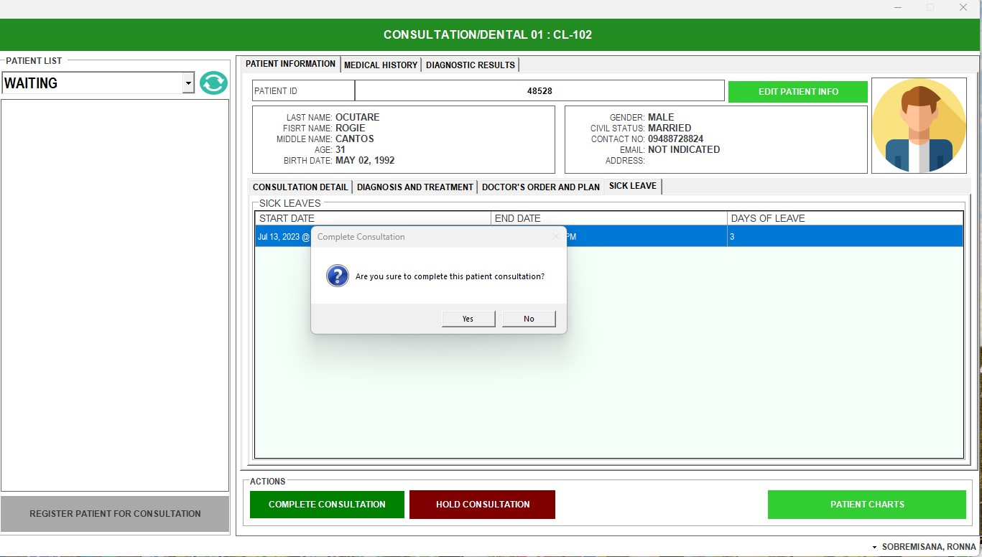
CLICK YES, IF COMPLETED TRANSACTION THEN THE PATIENT WILL NOW PROCEED TO DIAGNOSTICS ENCODER FOR DX QUEUING.

Slide 54
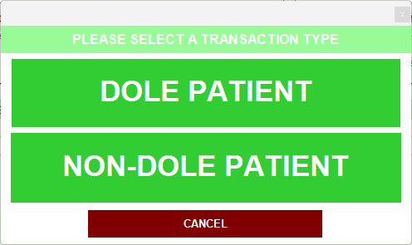
CLICK NON-DOLE PATIENT BECAUSE PRIVATE
PHARMACY AREA

Slide 55
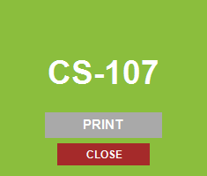
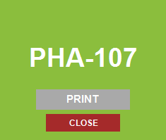
THEN QMS WILL GENERATE NUMBER FOR THE NEXT TRANSACTION
NOTE: IF THERE ARE REQUEST FOR DIAGNOSTICS, MULTIPLE GENERATION OF PRINTED NUMBER WILL APPEAR. THEN THE DOCTORS WILL WRITE THE TRANSACTION NUMBER AT THE BACK OF THE PAPER

Slide 56

SERVE PATIENT

Slide 57

CHECK THE REQUEST

Slide 58

RENDER ALL THE REQUEST IN HIS, THEN TRANSFER PATIENT TO DEPARTMENT WITH REQUEST

Slide 59


Slide 60
NOTE:
IF THE PAYMENT OF THE PATIENT IS:
LAB DIAGNOSTICS - TRANSFER TO LABORATORY
RAD DIAGNOSTICS - TRANSFER TO RADIOLOGY
CONSULTATION PAYMENT - TRANSFER TO SPECIFIED PCC DOCTOR
AND GIVE THE PRINTED TICKET TO THE PATIENT

Slide 61

PHARMACY WILL SEE THE PATIENT LIST THEN CLICK SERVE PATIENT AND RENDER THE REQUEST FROM THE DOCTOR

Slide 62

PHARMACY WILL CLICK REGISTRATION & RECORDS

Slide 63

PHARMACY WILL THEN CLICK THE PRESENT DATE & PRINT FORM

Slide 64

PHARMACY WILL THEN CLICK RX / PRESCRIPTION

Slide 65

QMS WILL THEN GENERATE THE PRESCRIPTION

Slide 66

LABORATORY & RADIOLOGY
SERVE PATIENT

Slide 67

CHECK THE REQUESTED DIAGNOSTICS, PERFORM IT AND CLICK COMPLETE TRANSACTION

